Slide 1
Testing Agile Based Software cont …
Prof. Durga Prasad Mohapatra
Dept. of CSE, NIT Rourkela
India

Slide 2
Scrum

Slide 3
Introduction
Scrum is an Agile framework which concentrates on how team members should function to produce system flexibly in a constantly changing environment.
Scrum is concerned with the product owner, project lead, and the team working together in an intensive and interdependent manner.

Slide 4
Introduction cont …
Scrum process includes three phases:
Pre-game
Development
Post-game

Slide 5
Introduction cont …
There are six identifiable roles in Scrum that have different tasks and purposes during the process and its practices:
Scrum master
Product owner
Scrum team
Customer
User
Management

Slide 6
Scrum: Characteristics
Self-organizing teams
Product progresses in a series of month-long sprints (iterations or runs or development cycles)
Requirements are captured as items in a list, called product backlog
One of the agile processes

Slide 7
Scrum Life Cycle
Daily Scrum
Sprint
planning
Sprint
review
Scrum
Sprint
backlog
Product backlog
Product
increment
Daily Scrum Meeting
Design
Code
Test

Slide 8
Sprint
Scrum projects progress in a series of “sprints”
Analogous to XP iterations or time boxes
Target duration is one month
Software increment is designed, coded, and tested during the sprint
No changes are entertained during a sprint

Slide 9
Scrum Framework
Roles: Product Owner, Scrum Master, Scrum Team, Customer, End User, Management
Ceremonies: Sprint Planning, Sprint Review, Sprint Retrospective, and Daily Scrum Meeting
Artifacts: Product Backlog, Sprint Backlog, and Burndown Chart

Slide 10
Key Roles and Responsibilities in a Scrum Team
Product Owner
Represents customers’ views and interests.
Development Team
Team of 5 - 10 people with cross-functional skill sets.
Scrum Master (aka Project Manager)
Facilitates scrum process and resolves impediments at the team and organization level by acting as a buffer between the team and outside interference.

Slide 11
Product Owner
Defines the features of the product
Decides on release date and content
Prioritizes features according to usefullness
Adjusts features and priority every iteration, as needed
Accepts or reject work results.

Slide 12
The Scrum Master
Represents management in the project
Removes impediments
Ensures that the team is fully functional and productive
Enables close cooperation across all roles and functions
Shields the team from external interferences

Slide 13
Scrum Team
Typically 5-10 people
Cross-functional
Quality Assurance Engineers, Programmers, UI Designers, etc.
Teams are self-organizing
Membership can change only between sprints

Slide 14
Sprint
Fundamental process flow of Scrum
It is usually a month-long iteration:
during this time an incremental product functionality is completed
No outside influence is allowed to interfere with the Scrum team during the Sprint
Each day begins with the Daily Scrum Meeting

Slide 15
Ceremonies
Sprint Planning Meeting
Daily Scrum
Sprint Review Meeting

Slide 16
Sprint Planning
Goal is to produce Sprint Backlog
Product owner works with the Team to negotiate what Backlog Items
Scrum Master ensures that the Team agrees to the realistic goals

Slide 17
Daily Scrum
Daily
15-minutes
Stand-up meeting
Not for problem solving
Three questions:
What did you do yesterday?
What will you do today?
What obstacles are in your way?

Slide 18
Daily Scrum
Is NOT a problem solving session
Is NOT a way to collect information about WHO is behind the schedule
Is a meeting in which team members review what is done and make informal commitments to each other and to the Scrum Master
Is a good way for a Scrum Master to track the progress of the Team

Slide 19
Sprint Review Meeting
Team presents what it accomplished during the sprint
Typically takes the form of a demo of new features
Informal
2-hour prep time rule
Participants
Customers
Management
Product Owner
Other team members

Slide 20
Product Backlog
A list of all desired work on the project
Usually a combination of
story-based work (“let user search and replace”)
task-based work (“improve exception handling”)
List is prioritized by the Product Owner
Typically a Product Manager, Marketing, Internal Customer, etc.

Slide 21
Product Backlog
Requirements for a system, expressed as a prioritized list of Backlog Items
Managed and owned by Product Owner
Spreadsheet (typically)

Slide 22
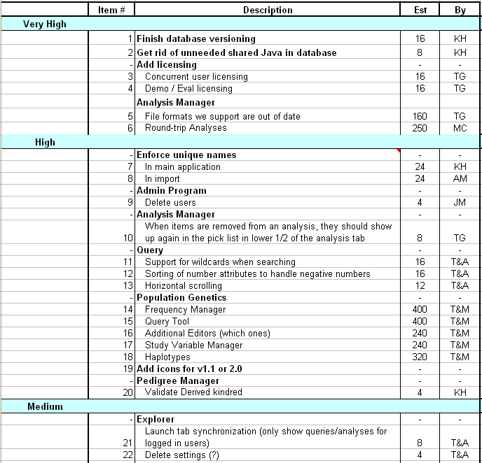
Sample Product Backlog

Slide 23
Sprint Backlog
A subset of Product Backlog Items, which defines the work for a Sprint
Created by Team members
Each Item has it’s own status
Updated daily

Slide 24
Sprint Backlog during the Sprint
Changes occur:
Team adds new tasks whenever they need in order to meet the Sprint Goal
Team can remove unnecessary tasks
But, Sprint Backlog can only be updated by the team
Estimates are updated whenever there’s new information

Slide 25
Burn down Charts
Are used to represent “work done”.
Are remarkably simple but effective Information disseminators
3 Types:
Sprint Burn down Chart (progress of the Sprint)
Release Burn down Chart (progress of release)
Product Burn down chart (progress of the Product)

Slide 26
Sprint Burn down Chart
Depicts the total Sprint Backlog hours remaining per day
Shows the estimated amount of time to complete
Ideally should burn down to zero to the end of the Sprint
Actually is not a straight line

Slide 27
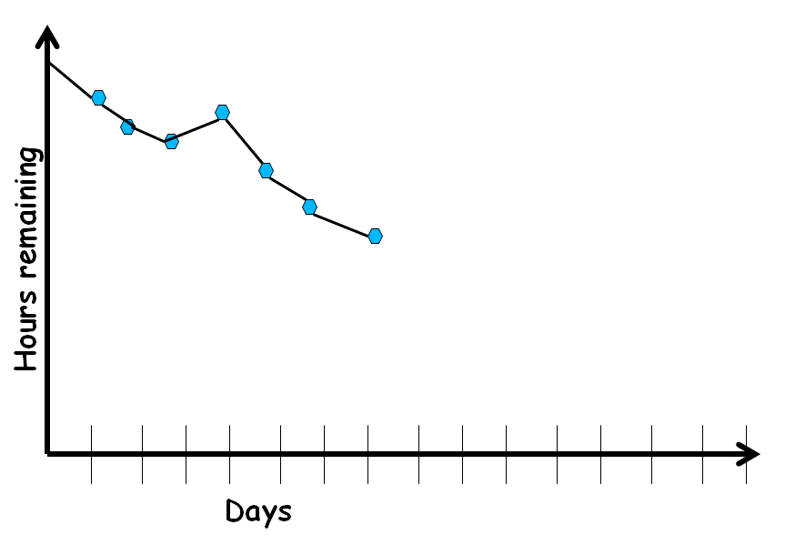
Sprint Burndown Chart

Slide 28
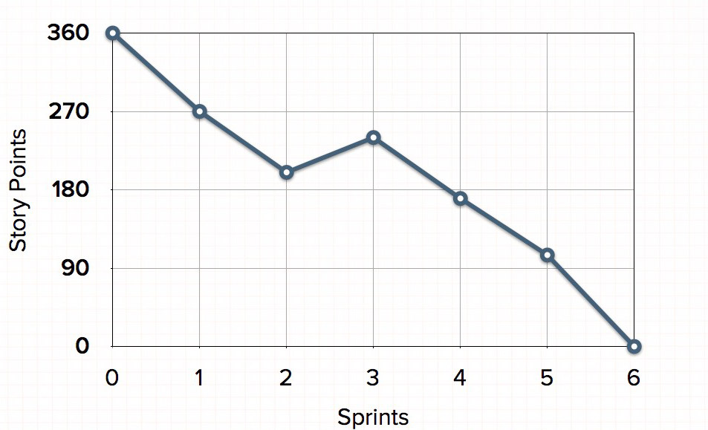
Release Burndown Chart
Will the release be done on right time?
How many more sprints?
X-axis: sprints
Y-axis: amount of story points remaining

Slide 29
Product Burndown Chart
It is a “big picture” view of project’s progress (all the releases)
Actual
burndown
Story
points
Expected
burndown
Sprint

Slide 30
Scalability of Scrum
A typical Scrum team is 6-10 people
Jeff Sutherland - up to over 800 people
“Scrum of Scrums” or “Meta-Scrum”

Slide 31
Summary
Discussed the basic concepts of Scrum.
Presented the characteristics of Scrum.
Explained the Scrum Life Cycle.
Discussed the Scrum Framework.
Roles
Ceremonies
Artifacts
Explained the Burn down Charts.

Slide 32
References
Rajib Mall, Fundamentals of Software Engineering, Fifth Edition, PHI, 2018.
Naresh Chauhan, Software Testing: Principles and Practices, (Chapter – 16), Second Edition, Oxford University Press, 2018.

Slide 33
Thank You

